Slide 1
DevOps Overview
SE489: DevOps Engineering

Slide 2
Outline
Why DevOps?
What is DevOps?
DevOps Stages and Tools
DevOps Use Case

Slide 3
Why DevOps?

Slide 4

Waterfall Model
Distinct goals for each phase of Development
After each step is finished, there is no way to go back
Linear/Sequential

Slide 5
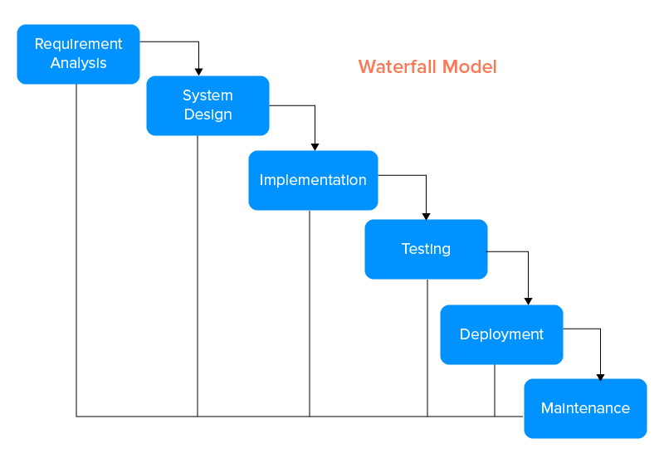
Waterfall Model

Slide 6
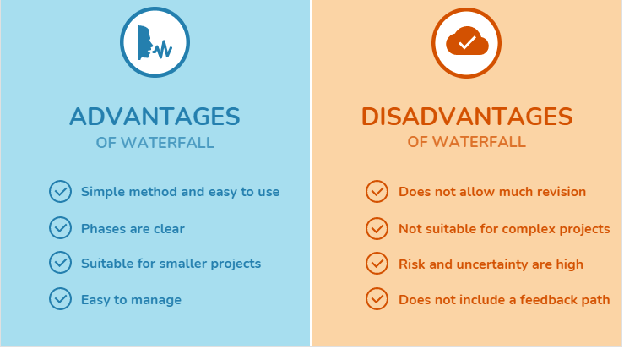
Limitations of Waterfall Model

Slide 7
Limitations of Waterfall Model
High amounts of risk and uncertainty
Not a good model fro complex and objec-oriented projects
Not suitable for the projects where requirements are at moderate to hgih risk of changing
No working software is produced until late during the lifecycle
Once an application is in the testing stage, it is very difficult to go back and change something

Slide 8
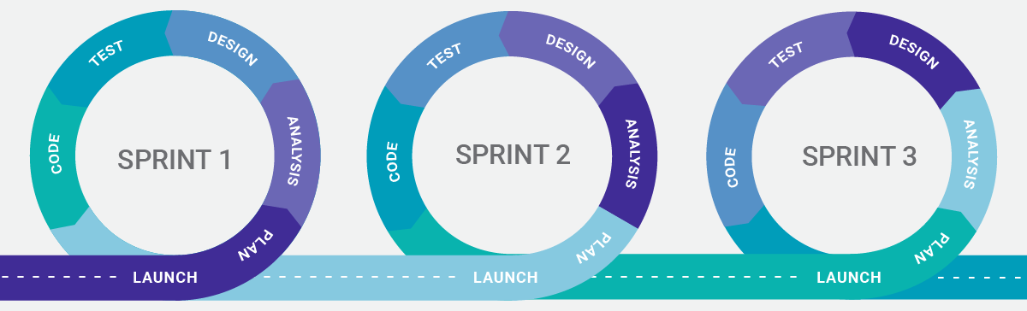
What is Agile Methodology?
Each project is broken up into several iterations/sprints
All iterations should be of the same time duration (between 2 to 8 weeks)
At the end of each iteration, a working product should be delivered

Slide 9
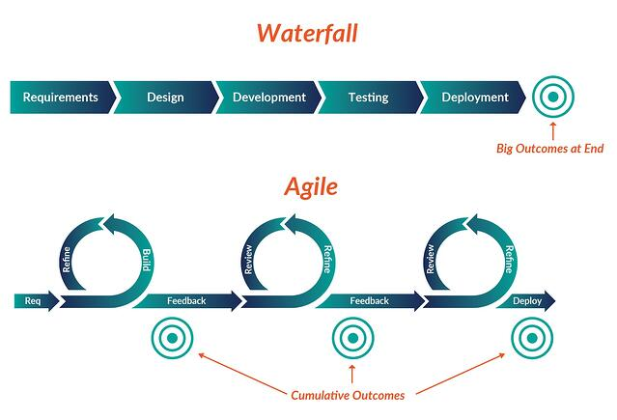
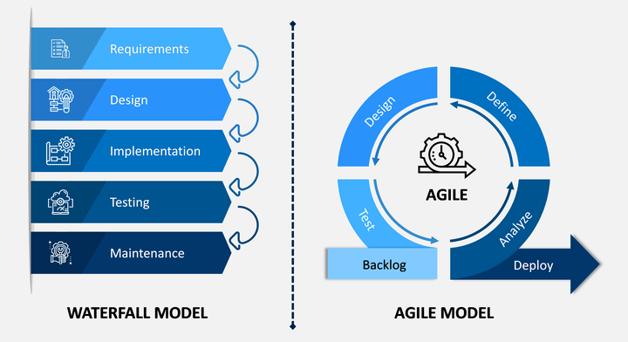
Waterfall vs Agile

Slide 10
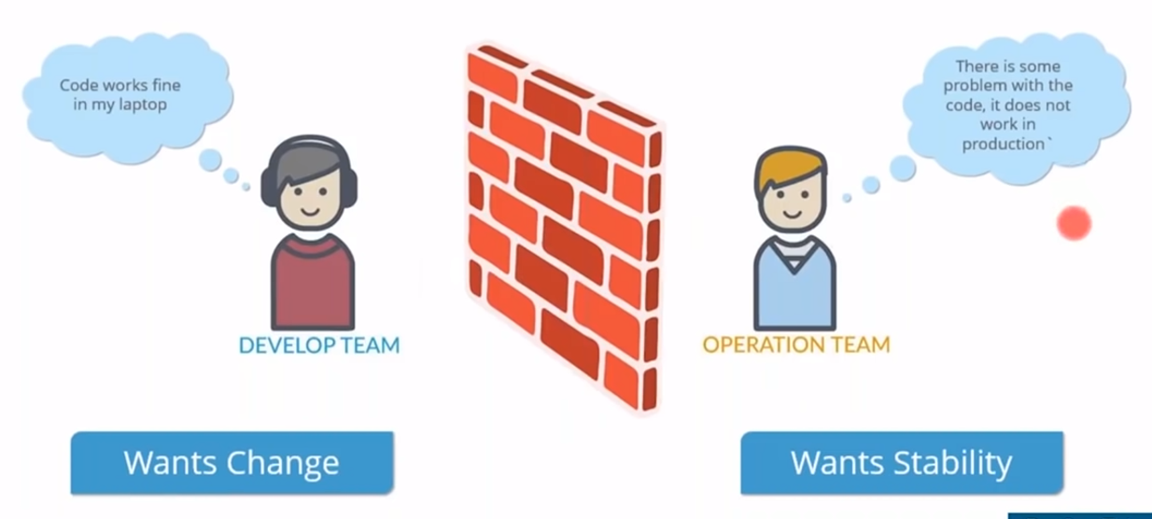
Limitations of Agile

Slide 11
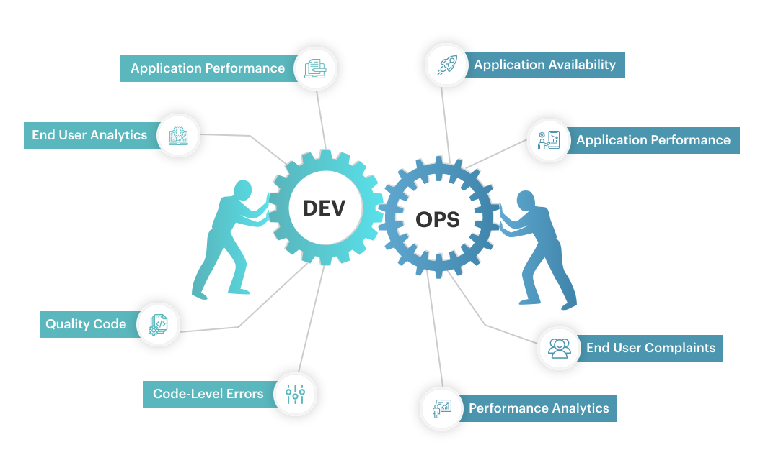
Solution is DevOps

Slide 12
Why DevOps?
DevOps enables us to simultaneously improve:
Organizational performance
Achieve the goals of all the various functional technology roles (e.g., Development, QA, IT Operations, Infosec)
Improve the human condition
DevOps shows us that when we have the right architecture, the right technical practices, and the right cultural norms:
Small teams of developers are able to quickly, safely, and independently develop, integrate, test, and deploy changes into production.

Slide 13
DevOps
High-performing organizations using DevOps practices were outperforming their non–high performing peers in the following areas:
Throughput metrics
Code and change deployments (thirty times more frequent)
Code and change deployment lead time (two hundred times faster)
Reliability metrics
Production deployments (sixty times higher change success rate)
Mean time to restore service (168 times faster)
Organizational performance metrics
Productivity, market share, and profitability goals (two times more likely to exceed)
Market capitalization growth (50% higher over three years)

Slide 14
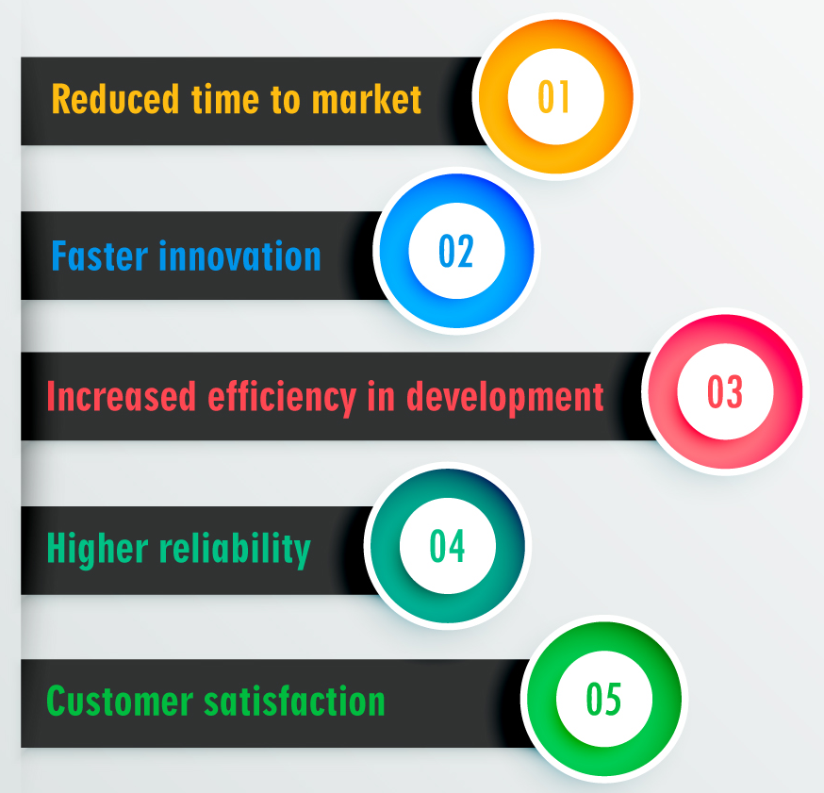
DevOps Benifits

Slide 15
What is DevOps?

Slide 16
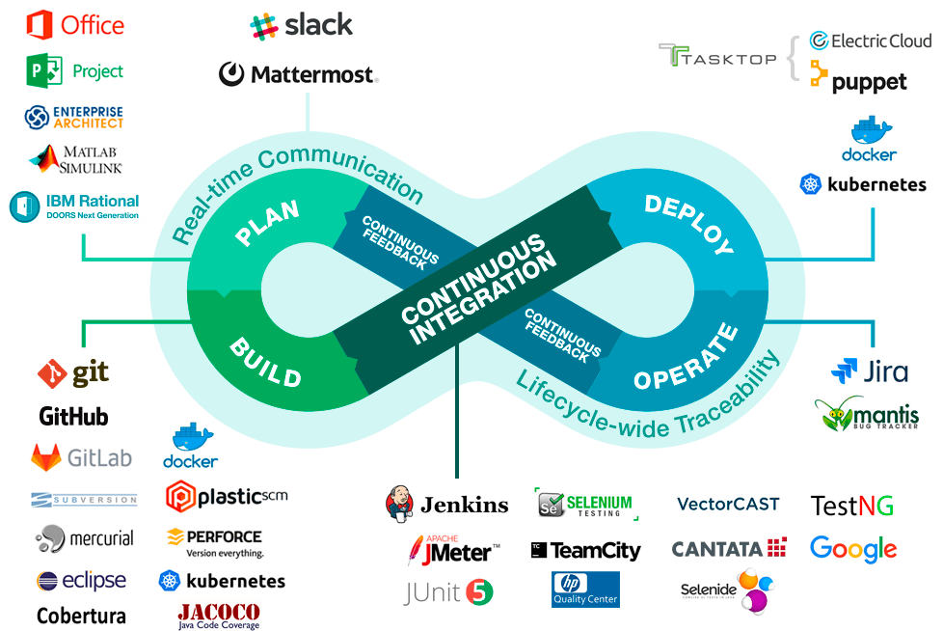
What is DevOps?

Slide 17
What is DevOps?
DevOps is a software development approach that unites the three crucial components
Development
Quality assurance
Operations.
It is a natural extension of Agile methodology that facilitates end-to-end responsibility, cross-functional components, and collaboration.
DevOps is a set of practices that help teams build, test, and deploy new software more efficiently and accelerate the bug elimination process.

Slide 18
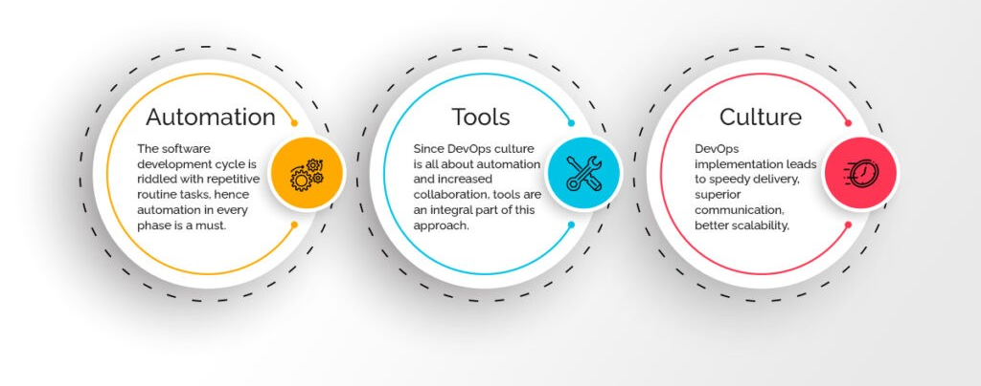
Core Fundamentals of DevOps

Slide 19
Core Fundamentals of DevOps
Automation:
It is the first step in making your organization DevOps-rich.
By creating a more efficient workflow, DevOps helps in keeping everything monitored and reported.
Tools:
DevOps culture is all about automation and increased collaboration
Culture:
DevOps implementation leads to speedy delivery, superior communication, better scalability, process automation, and a better environment for technical stability.
DevOps culture thus results in streamlining the software development life cycle at every stage.

Slide 20
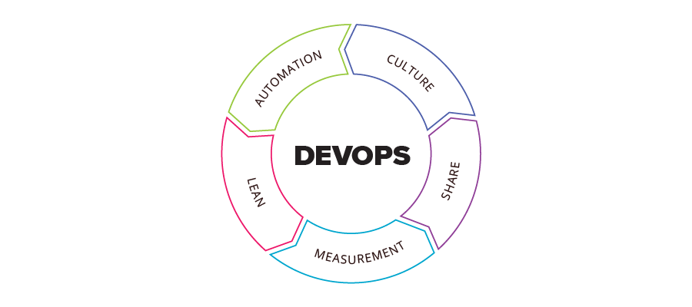
DevOps CALMS Framework
CALMS Framework
Assess your ability and measure progress on your DevOps journey

Slide 21
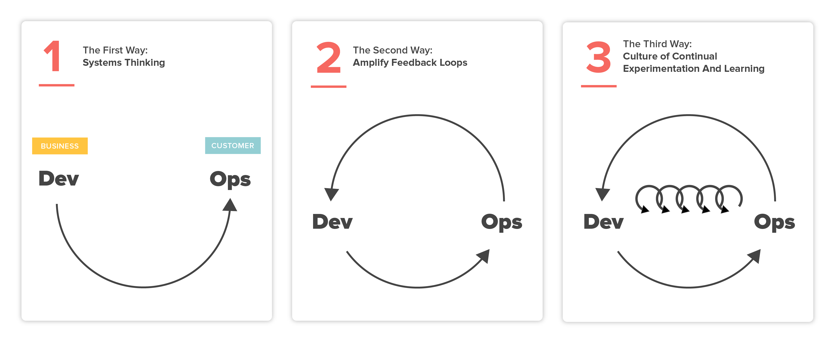
DevOps: The Three Way

Slide 22

The First Way: System Thinking
Technical Value Stream: Optimizing the process of delivering changes to the software.
It starts from the point where demand for a change or new feature is identified, through development, into operations where the value associated with the change is delivered to the customer.
It takes a complex systems view and emphasizes the optimization of the whole process rather than the individual parts.

Slide 23
The First Way: System Thinking
The flow can be increased using the following measures
Making work visible
Using visual work boards to make tasks visible.
Every person in a team can see which tasks are current, are being processed and where there are problems, and can then act based on this information.
Reduce the number of bundled tasks
The size of bundles of tasks should be reduced. By having a smaller number of tasks in a group, the risk of errors can be reduced.
Reduce dependencies and handovers
By redesigning the team organization and automating certain work processes, misunderstandings or loss of information during handovers can be prevented.
Eliminate the superfluous
All tools, processes or intermediate steps that have no value for the end user are eliminated.
Limit the number of orders
In order to be able to process orders completely, correctly and within the fixed deadlines, only a certain number of orders are assigned. These are tracked using a visual work board, which helps the team to focus on current work and pending tasks.
The goal is to achieve better collaboration and to improve the value stream

Slide 24
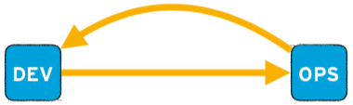
The Second Way: The Feedback Principle
Creating feedback loops from operations back to development.
It's about amplifying this feedback so the software and the process to change the software is continuously improved.
The goal is to understand feedback, respond to it and implement improvements based on it. By doing so, shorter (and therefore valuable) feedback loops are used to make necessary changes on a continuous basis.

Slide 25
The Second Way: The Feedback Principle
The flow can be increased using the following measures
Recognize problems as soon as they appear
Through feedback loops, individual components, connections and process steps can be measured quickly and their functionality can be checked.
Defects can be detected quickly and deviations can be resolved immediately.
Solve problems immediately (and together)
As soon as a problem emerges, the ongoing process is stopped and all team members involved help to solve the problem immediately.
Ensure quality from the ground up
As part of their daily work, employees should ensure that the quality of "their" work steps is sound. This means not only that the employee's commitment to the process is significantly more responsible, but the process remains lean, avoiding a complex system, which in turn reduces the likelihood of errors.
Thinking yourself into other people's roles
By imagining yourself in various roles, you are not only ensuring quality but also increasing your sense of responsibility towards your team mates. The focus here should be on the users and those involved in the processes of the subsequent steps, in order to create empathy with the people who will use the product.
It relies totally on a healthy feedback culture, which is essential to achieve quality, reliability and certainty. Errors and defects must be identified and considered honestly in a first step before they can be resolved.

Slide 26
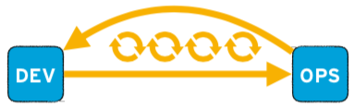
The Third Way: Continuous Learning and Experimentation
Creating a culture of experimentation and learning and ensuring that the processes for changing the software minimize the cost of failure so that failure is accepted as an integral feature of experimentation.
This means that the entire team can benefit from their successes and failures and implement improvements based on "real" results.
Ensures that an organization and its teams remain constantly able to adapt and act efficiently and independently of the environment.

Slide 27
The Third Way: Continuous Learning and Experimentation
The flow can be increased using the following measures
Schedule specific times for improvements
Teams should schedule specific times during which existing processes - regardless of their size and scope - are constantly improved. These are primarily the processes that form part of the team's daily work and which therefore need to be effective and efficient.
Experimentation helps with improvement
In addition to the specific scheduling of improvements, there needs to be experimentation with creating different scenarios during development, in order to uncover sources of errors, close gaps and find the optimum solution. Without this experimentation, alternatives that may work better than the current approach will never be found, resulting in both time savings and learning.
Share individual expertise
In order to develop comprehensive understanding and uniform expertise, it is important that the knowledge held by individual employees is shared with the team members. This results in everyone benefiting from the team's collective knowledge, which contributes to improved collaboration within the framework of the flow principle.
Motivate employees to work independently
No more managers handing out instructions. Instead, managers become coaches who act as sounding boards and encourage employees to think for themselves. This means encouraging team members to take the initiative in identifying and resolving problems independently in their daily work.
This approach can also help other organizations in their efforts to make improvements. Employees are the most important component here, because without motivated employees, the entire model is of little use.

Slide 28
DevOps Stages and Tools

Slide 29
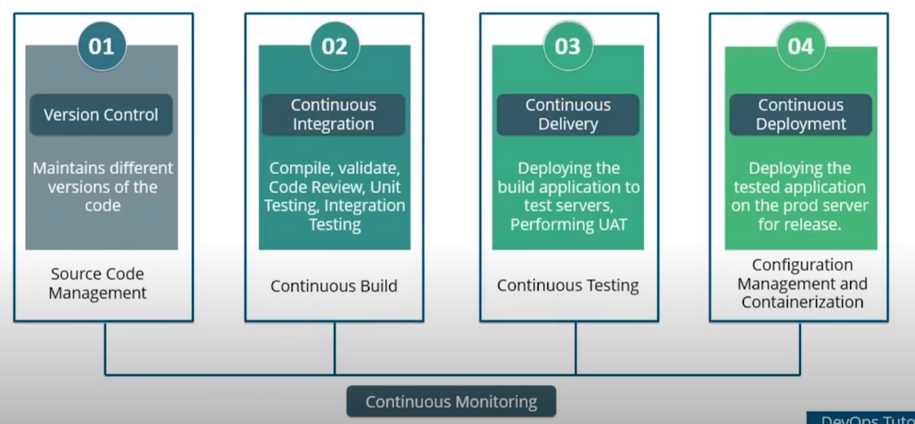
DevOps Stages
Notes:
The Guiana Space Centre or, more commonly, Centre spatial guyanais (CSG) is a French and European spaceport near Kourou in French Guiana.

Slide 30
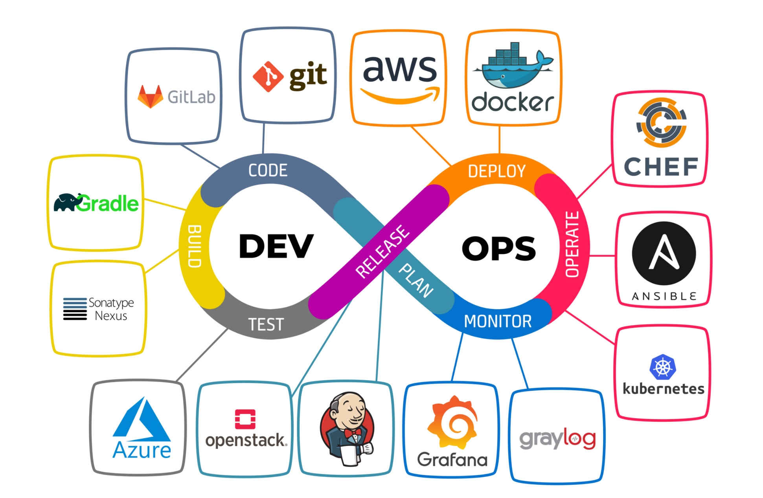
DevOps Tools

Slide 31
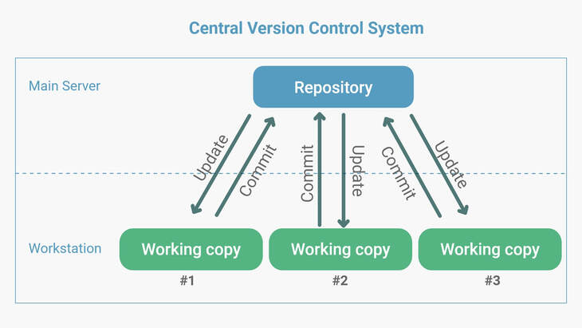
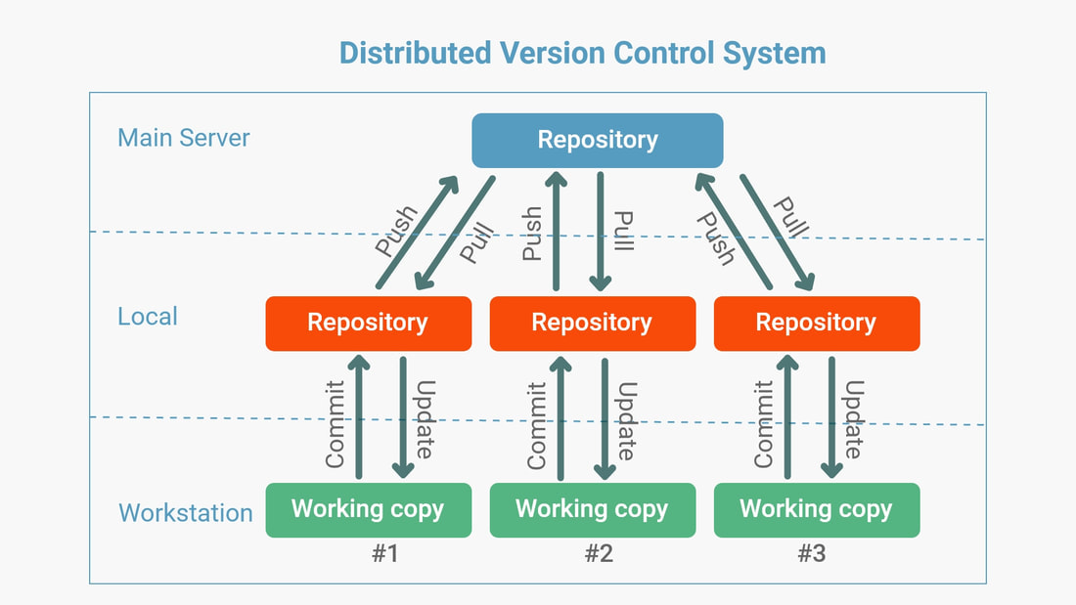
Source Code Management
The management of changes to documents, computer programs, large websites and other collection of information

Slide 32
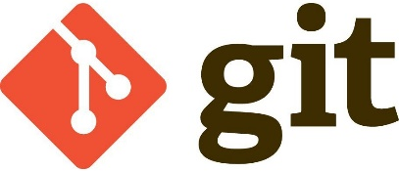
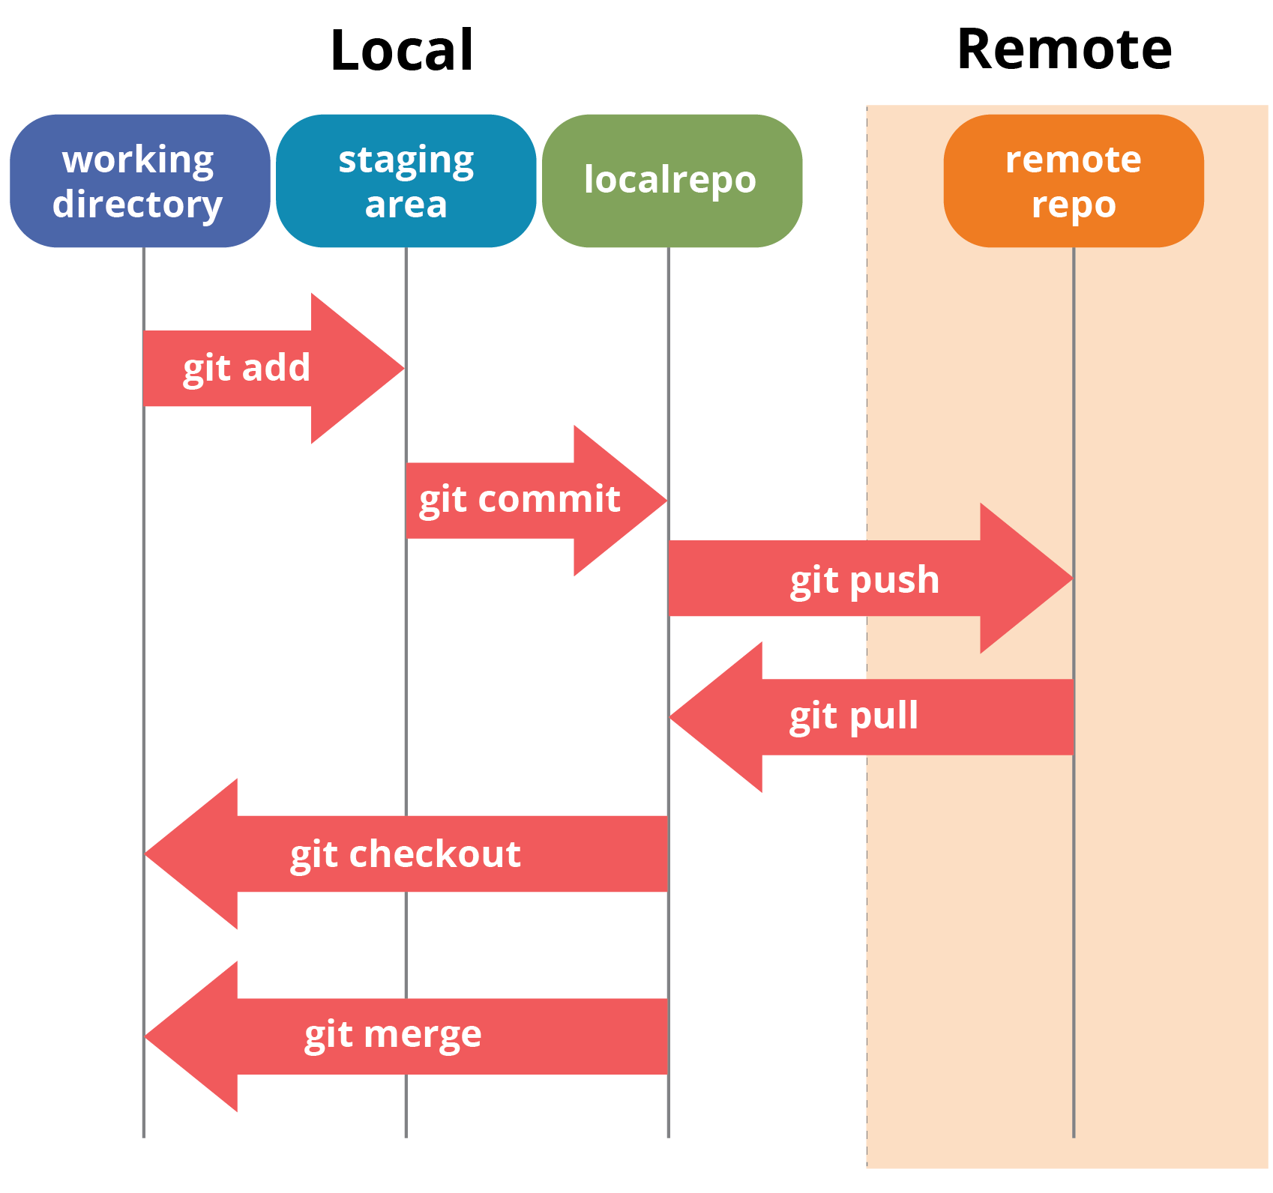
Source Code Management
Git is a Distributed Version Control tool that supports distributed non-linear workflows by providing data assurance for developing quality software

Slide 33
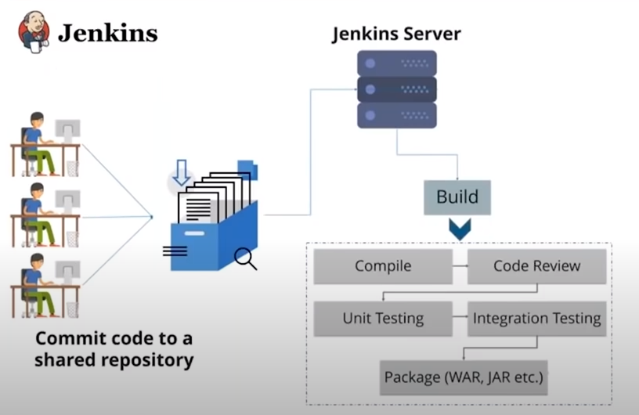
Continuous Integration

Slide 34
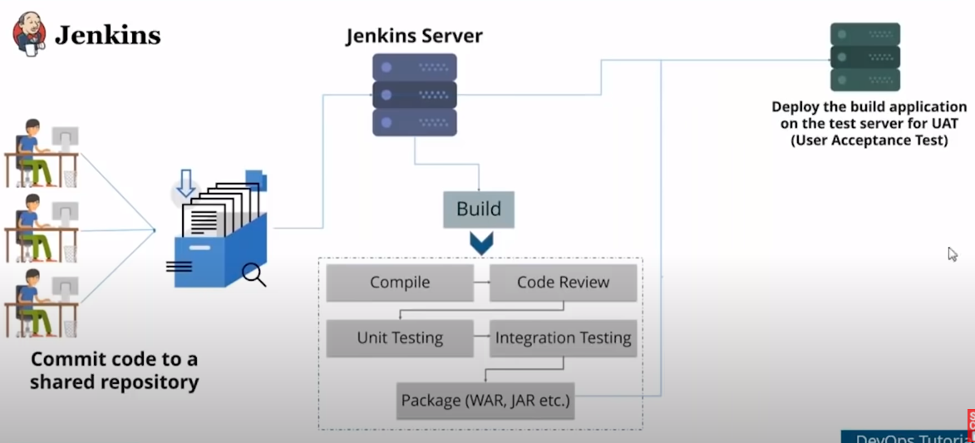
Continuous Delivery

Slide 35
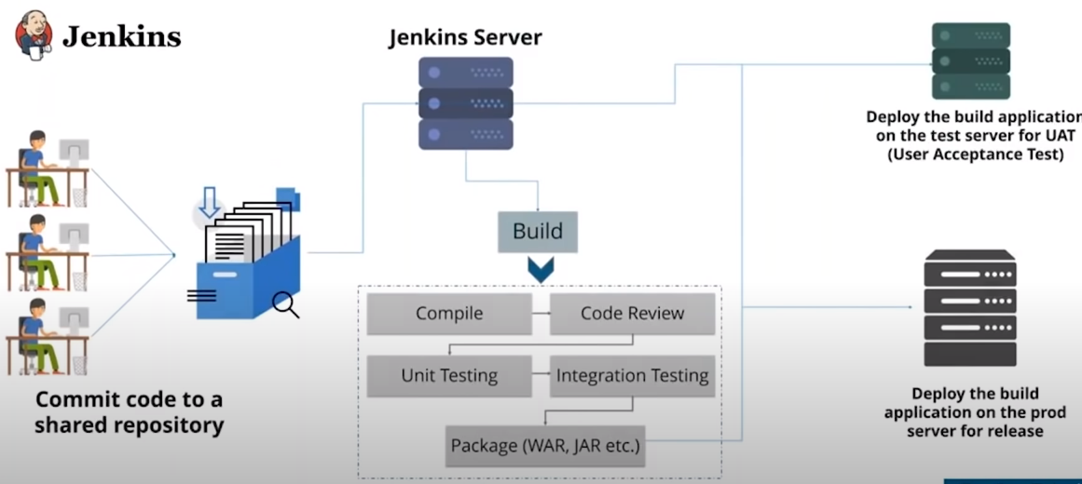
Continuous Deployment

Slide 36

Configuration Management
DEV
Configuration Management is the practice of handling changes systematically so that a system maintains its integrity over time
{ }
TEST
{ }
Configuration Management (CM) ensures that the current design and build state of the system is known, good and trusted
Code for Infrastructure
PROD
Provisioning of Dev, Test, and Prod environment
{ }
It does not rely on the tacit knowledge of the development team

Slide 37
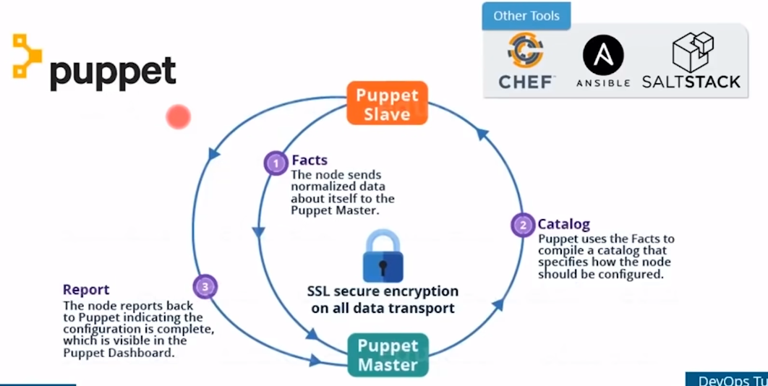
Configuration Management

Slide 38
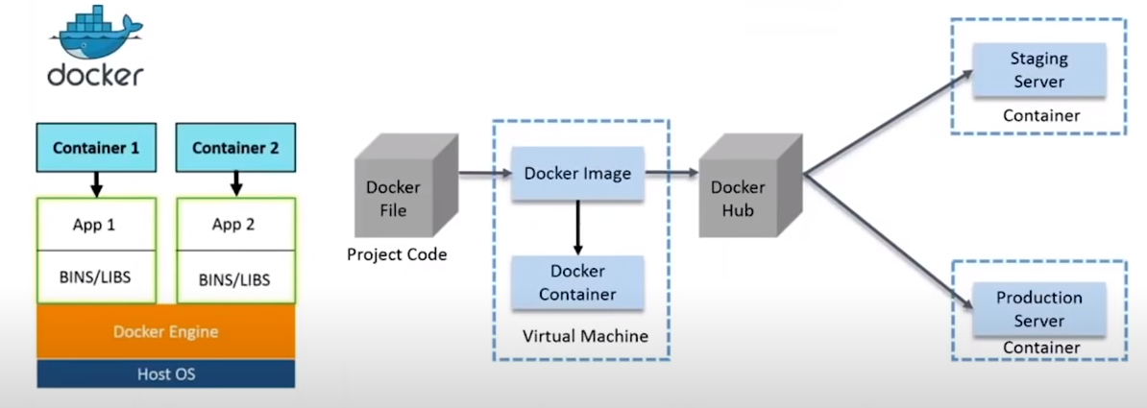
Containerization

Slide 39
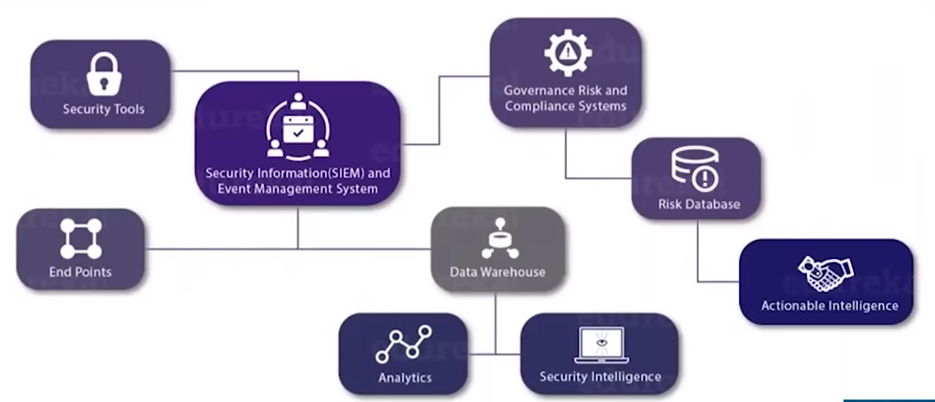
Continuous Monitoring
Continuous Monitoring is all about the ability of an organization to detect, report, respond, contain, and mitigate the attacks that occur, in its infrastructure

Slide 40
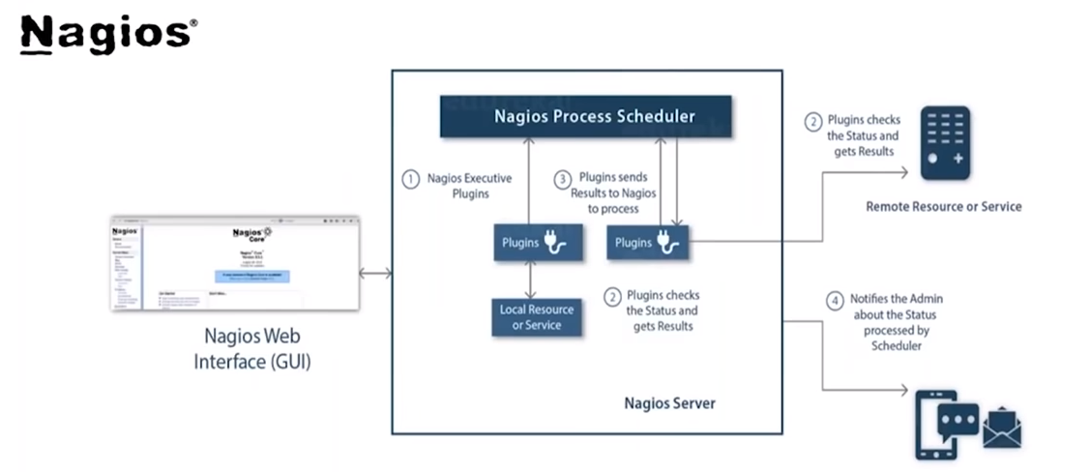
Continuous Monitoring

Slide 41
DevOps Case Study

Slide 42
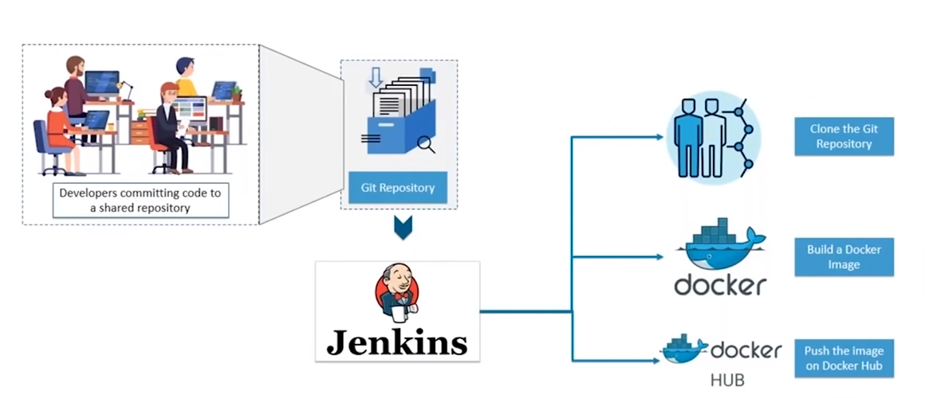
DevOps Use Case

